Slide 1
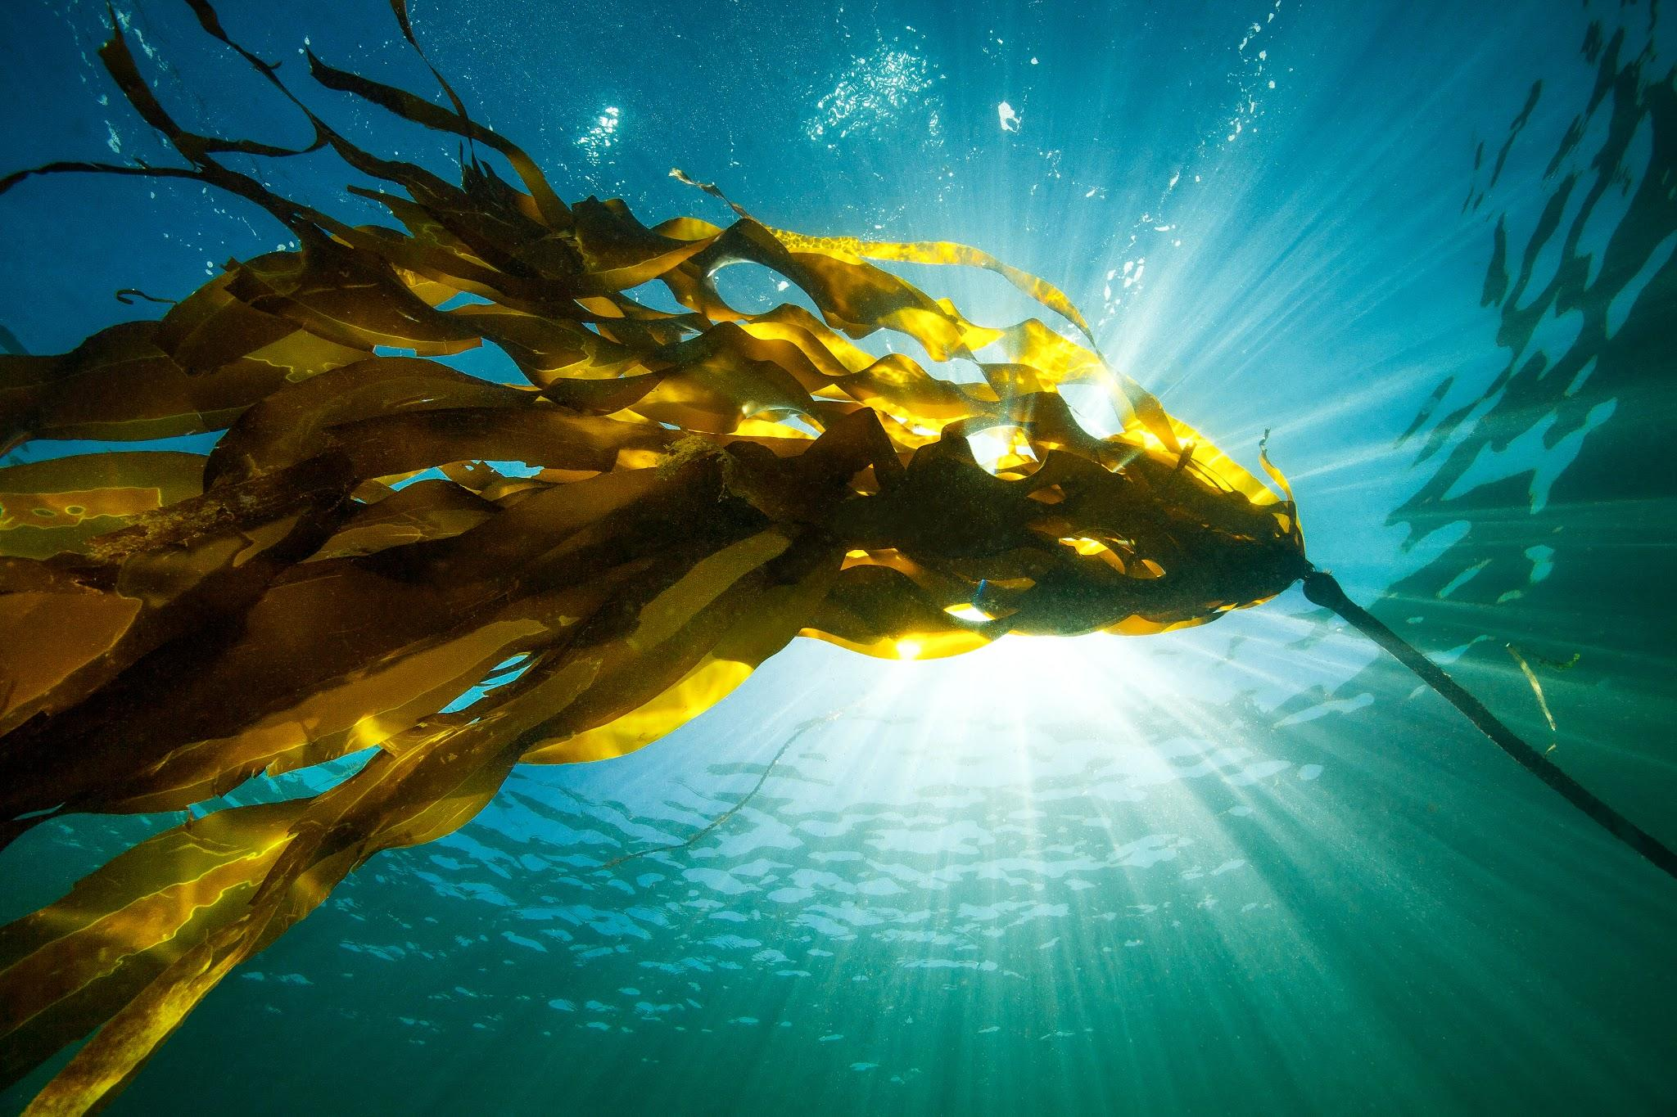
08.06.16 Ogden Point Victoria, B.C.
Emerald Forest
Scott Stevenson

Slide 2
Watch a preview

Slide 3
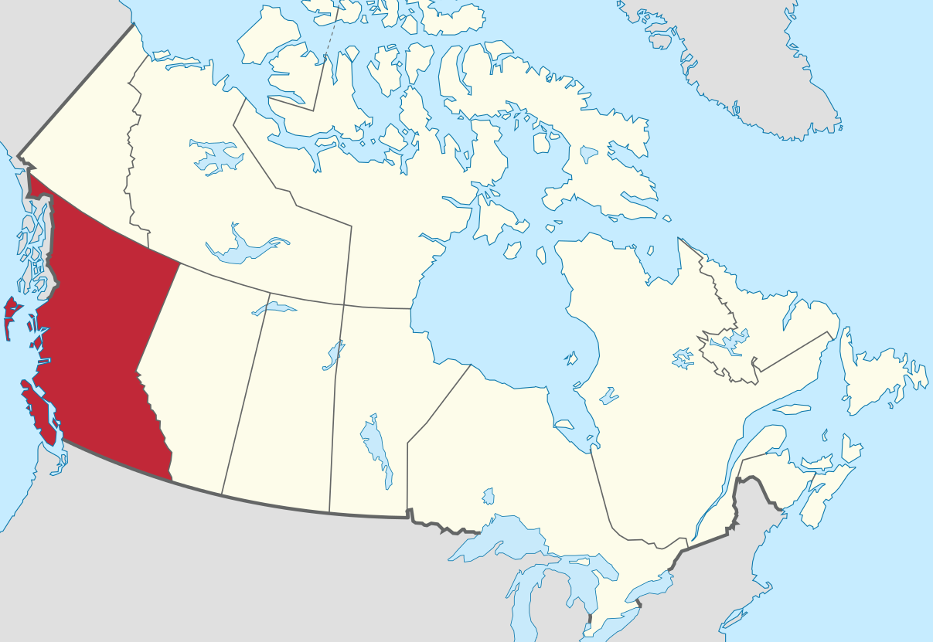
Where are we diving?
British Columbia, Canada
The dive will take place at
Ogden Point in Victoria.
Vancouver Island

Slide 4
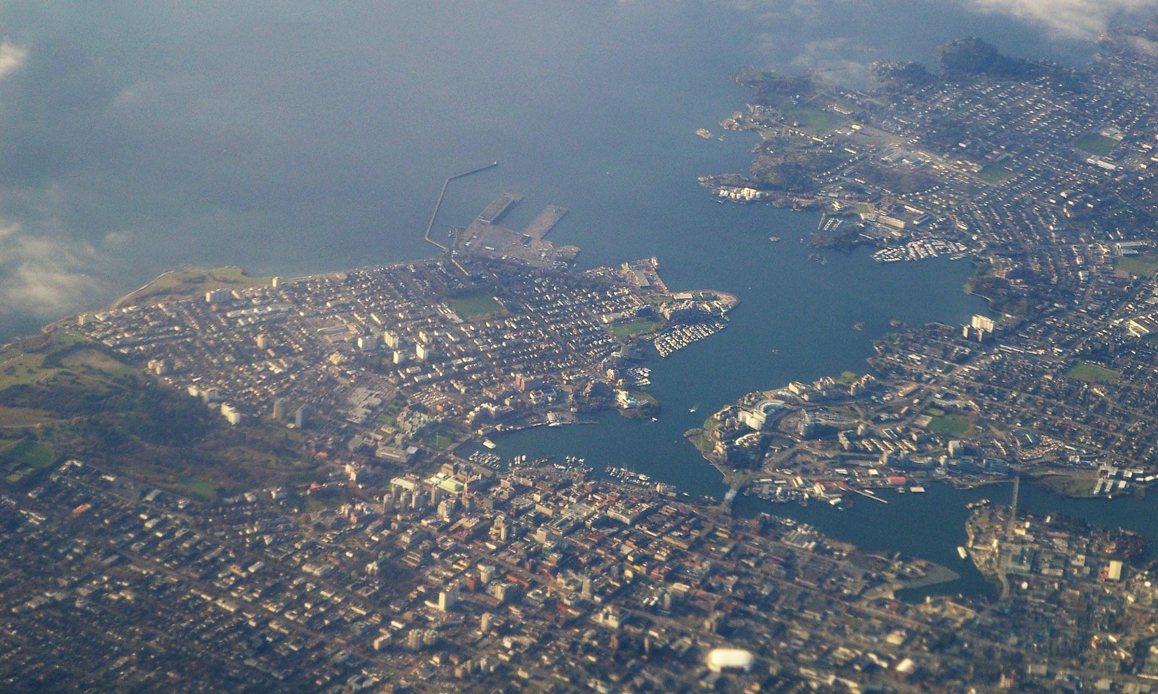
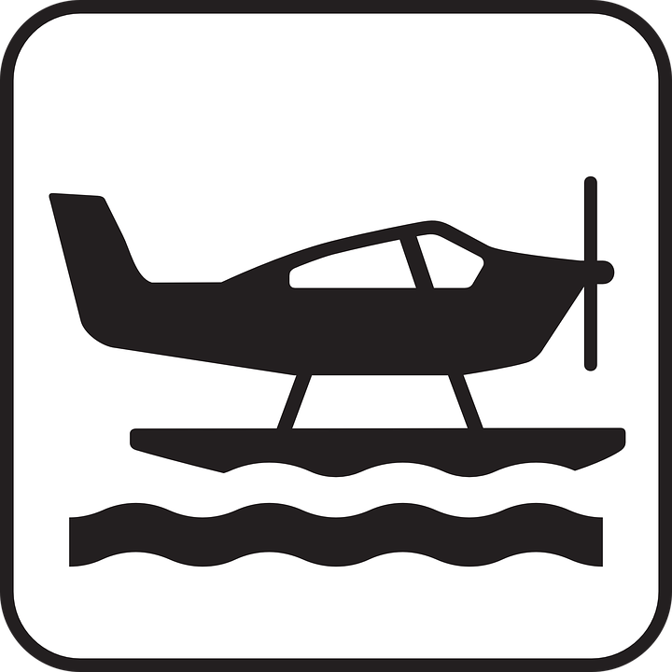
Ogden Point
Victoria Harbour serves as seaport for
cruise ships, seaplanes, ferries, and visitors.

Slide 5
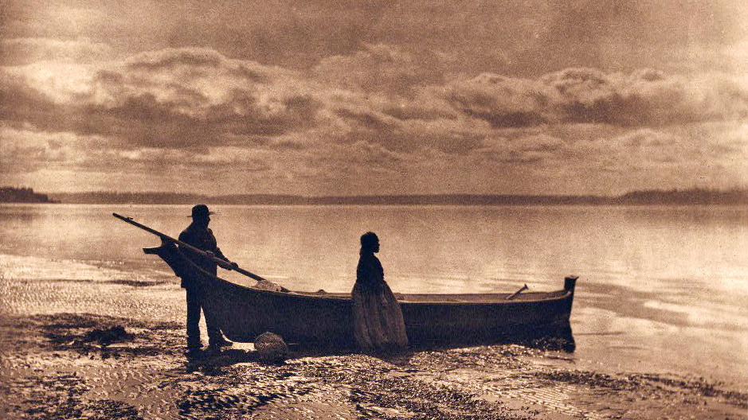
About the land
The Lekwungen People have gathered here
for thousands of years.

Slide 6
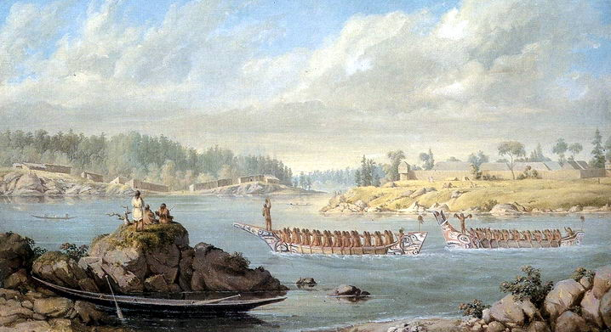
About the land
The Swengwhung tribe traditionally occupied this peninsula. Their descendants now make up
the Songhees and Esquimalt Nations.
"Return of a War Party," 1847. Songhees village (left) and Fort Victoria (right). Painting by Paul Kane (Royal Ontario Museum)

Slide 7
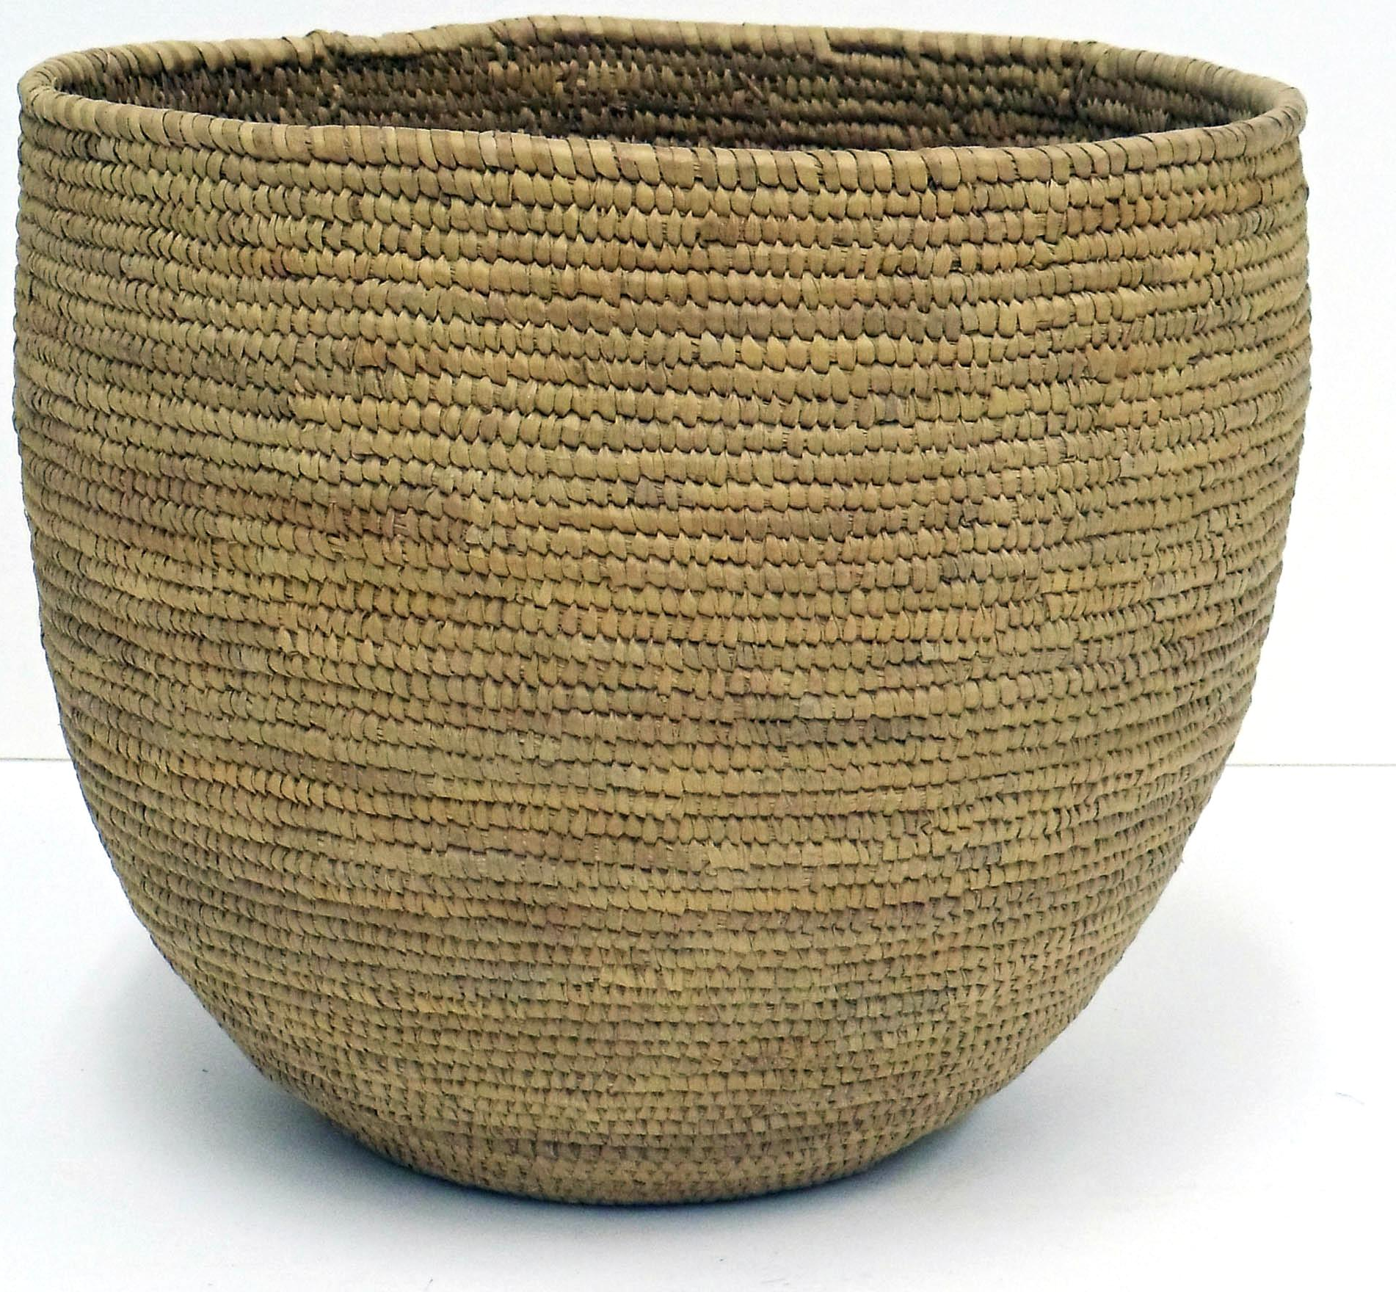
An abundance of marine resources were traditionally harvested in this area:
Fish - salmon, herring, halibut, rockfish, lingcod, flounder, sole, smelt
Shellfish - clams, mussels, sea urchins, chitons, barnacles
Also... seals, crabs, octopus, seaweed
Notes:
https://docs.neb-one.gc.ca/ll-eng/llisapi.dll/fetch/2000/90464/90552/548311/956726/2392873/2449925/2450020/2785351/C123-3-1_-_Written_Evidence_of_the_Esquimalt_Nation_-_A4L5L4.pdf?nodeid=2784464&vernum=-2

Slide 8
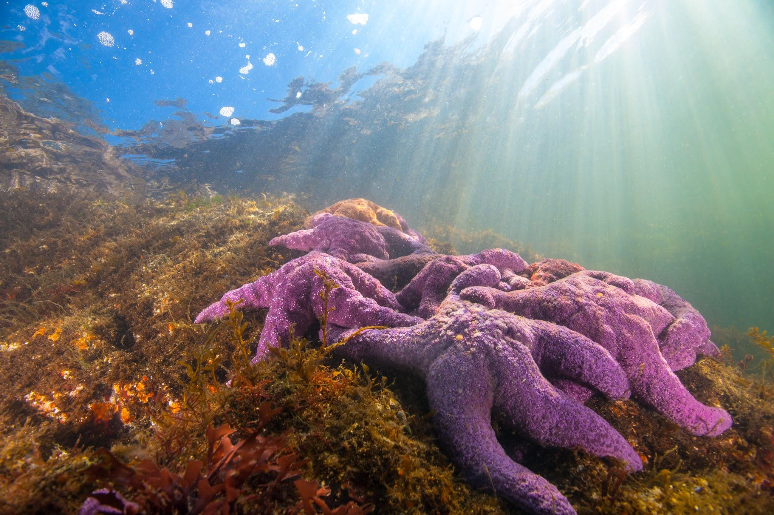
About the land
And to this day,
these waters support an incredible
biodiversity.
Scott Stevenson

Slide 9
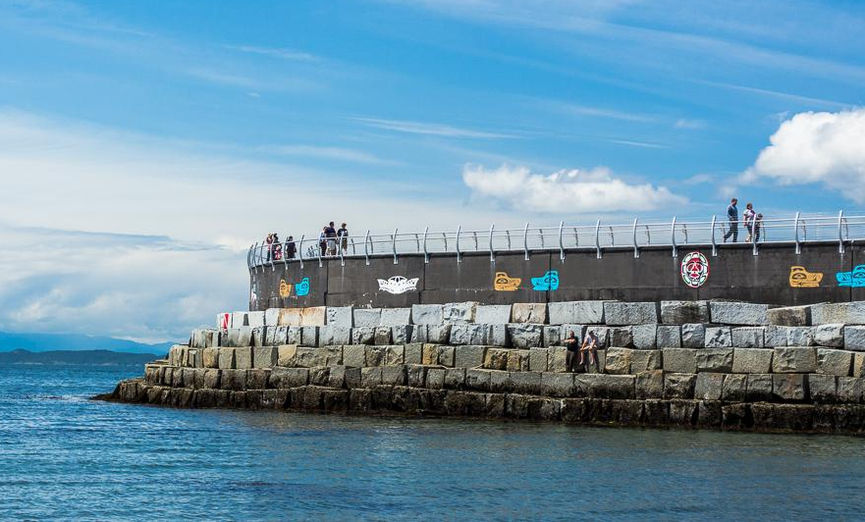
The dive site
The Ogden Point seawall protects boats from the waves and winds that come off the open ocean.
"Ogden Point Breakwater" (CC BY-NC-ND 2.0) by TylerIngram

Slide 10
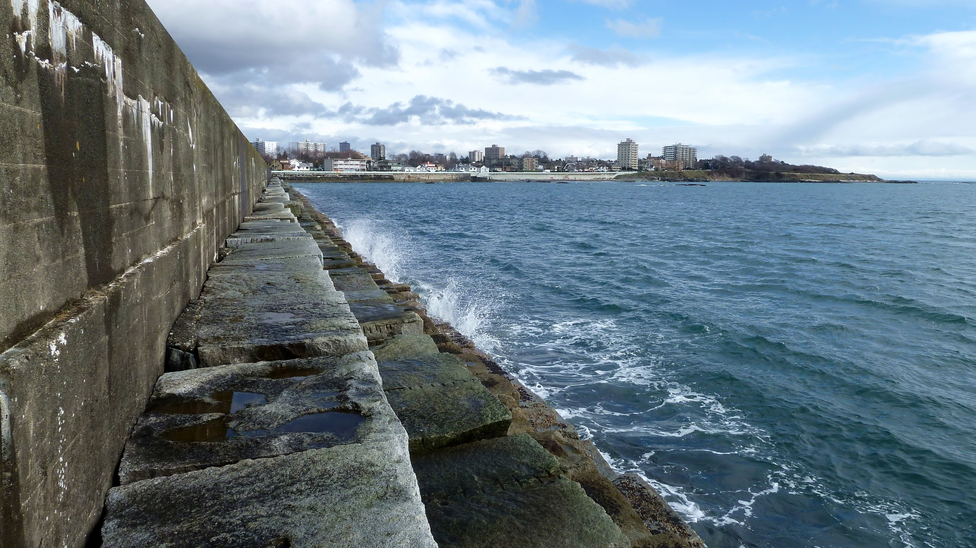
The dive site
The underwater terrain is quite varied. Mud, sand, rock and gravel create many habitats.
"Ogden Point Breakwater" (CC BY-NC-ND 2.0) by canoe too

Slide 11
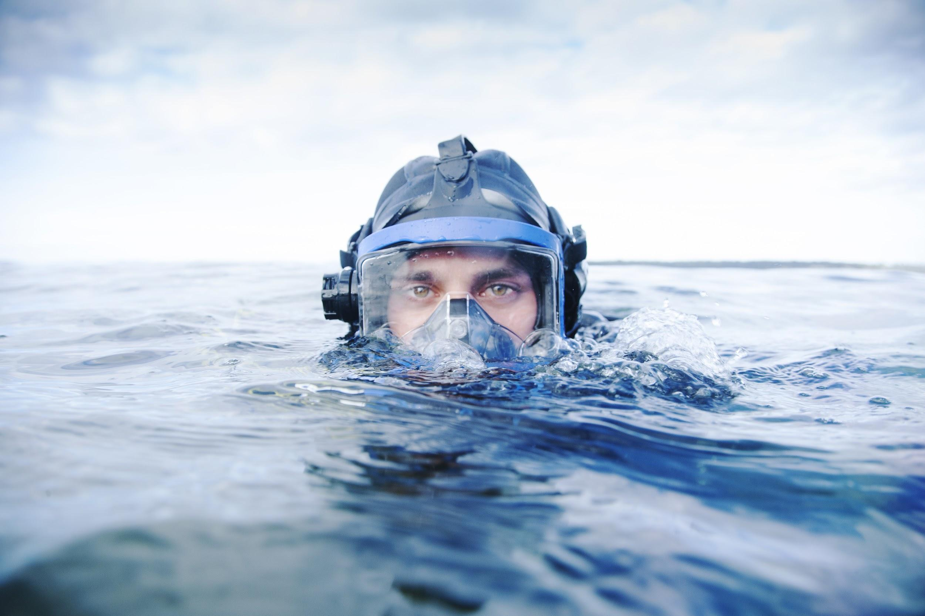
Our mission today is to explore a kelp forest.
Uvic Photo Services

Slide 12
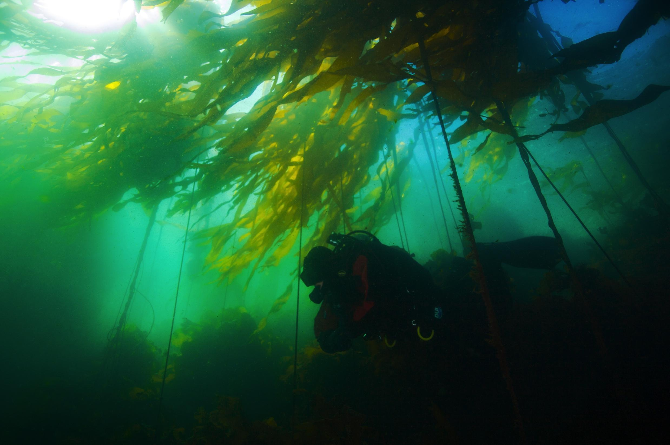
A kelp forest is
a unique ecosystem.
They are beautiful seascapes that are home to a multitude of living things.
We want YOU to explore and discover those wonders.

Slide 13
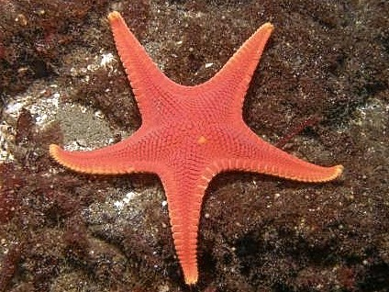
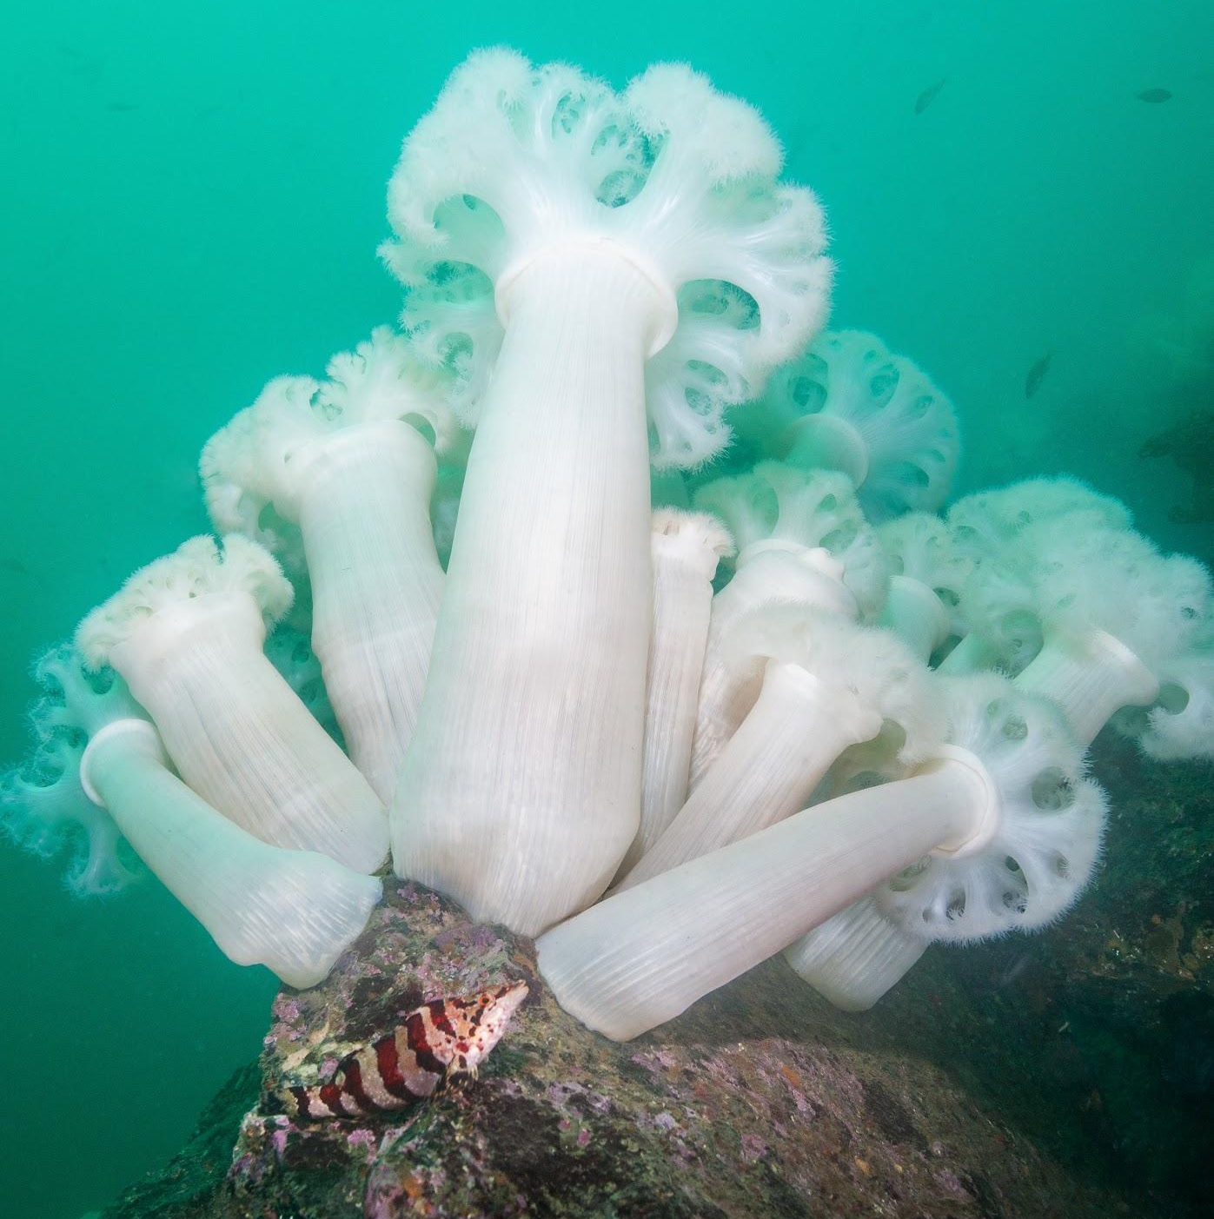
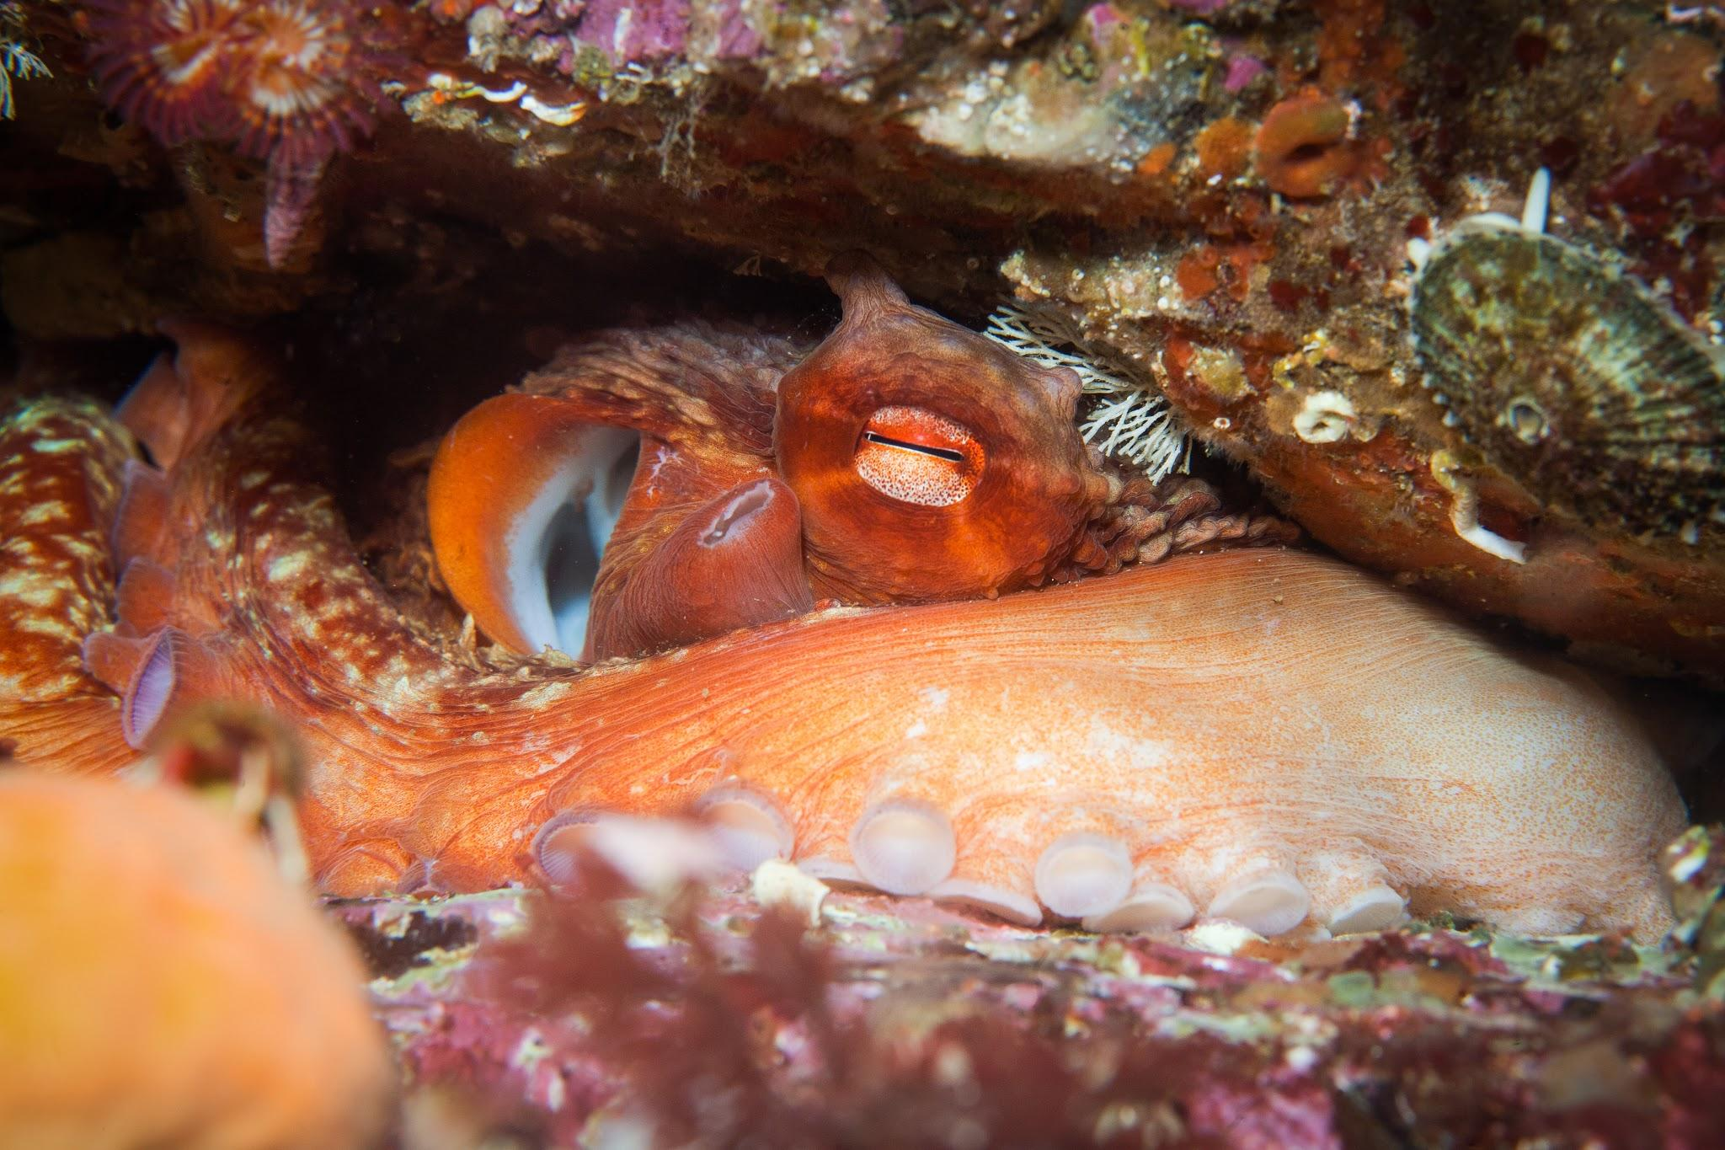
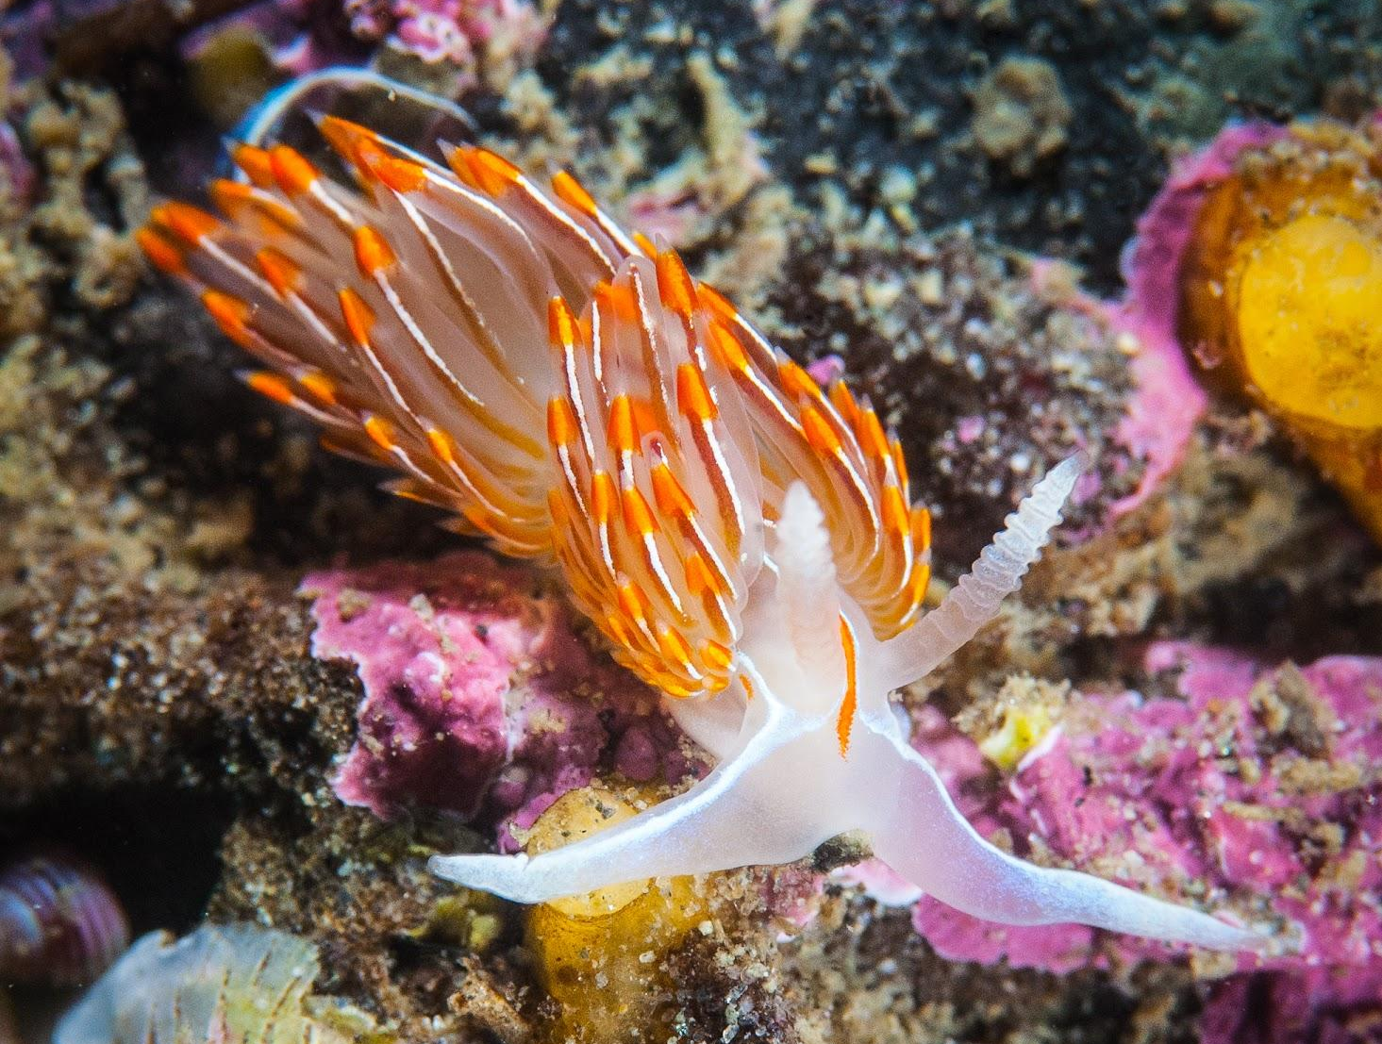
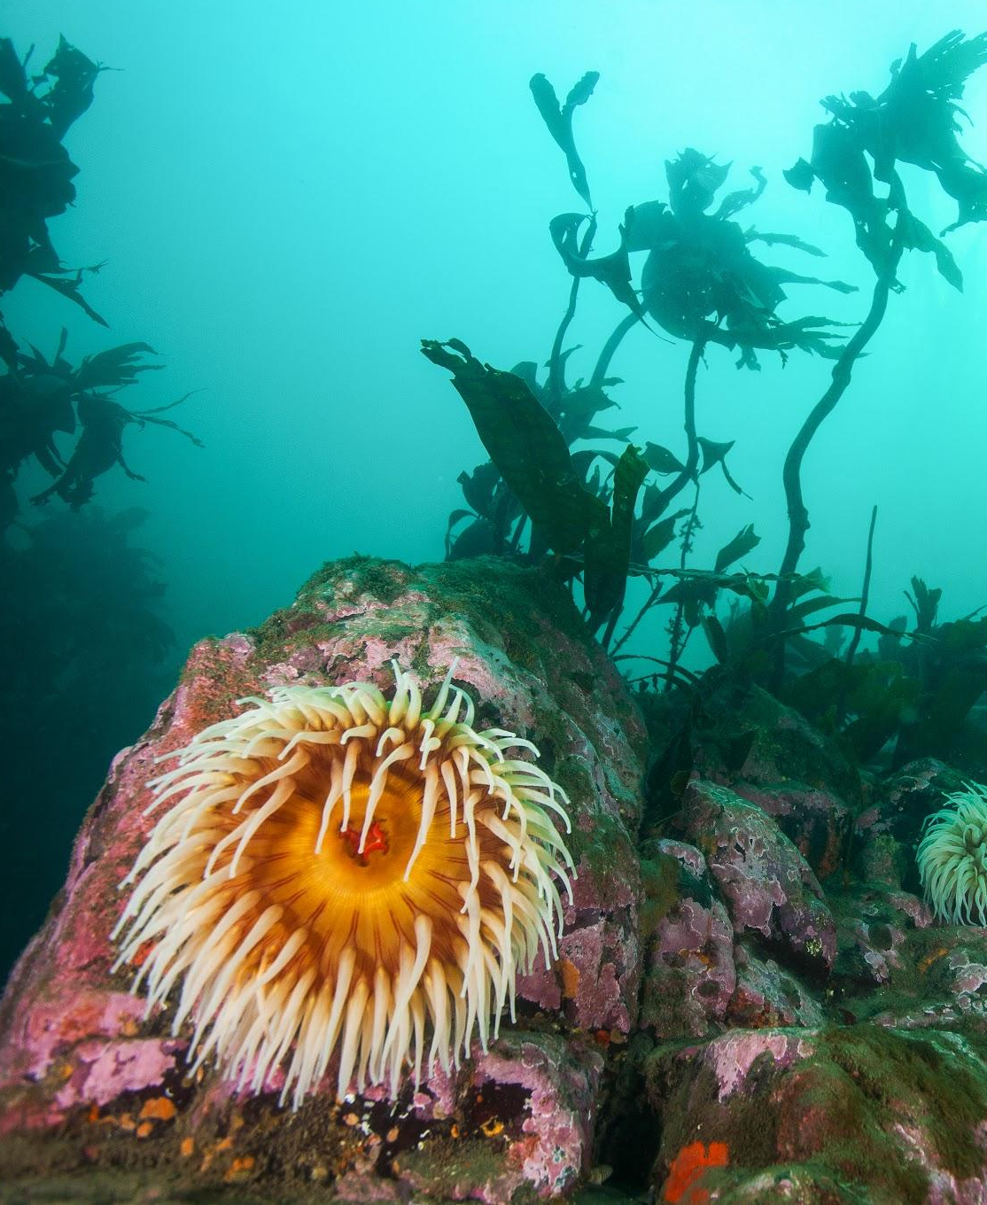
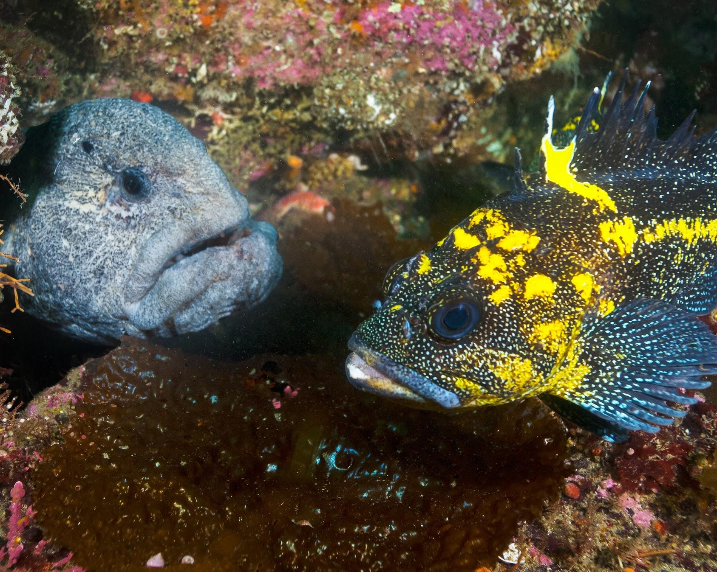
What lives there?

Slide 14
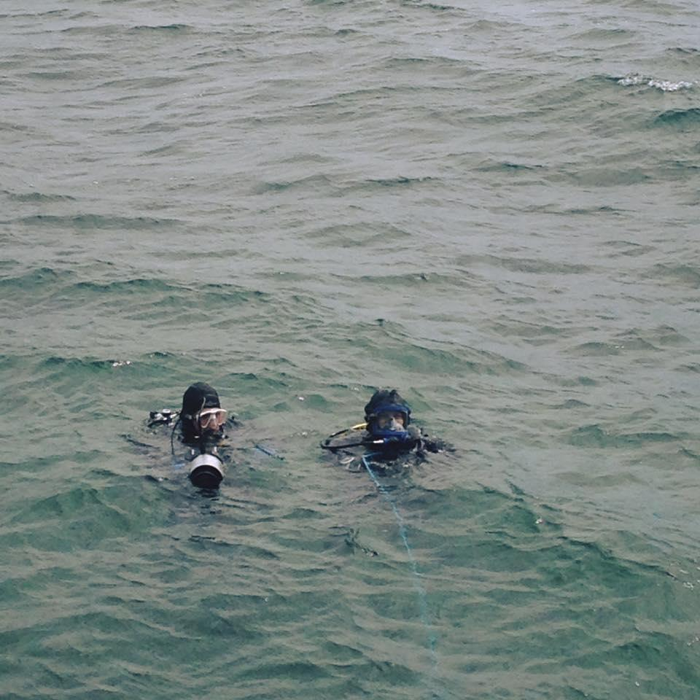
Divers need to be skilled at observation.
Can you make a list of the species you saw on the previous slide?
What else do you expect to see during your Live Dive?
What was that?
I can’t remember!

Slide 15
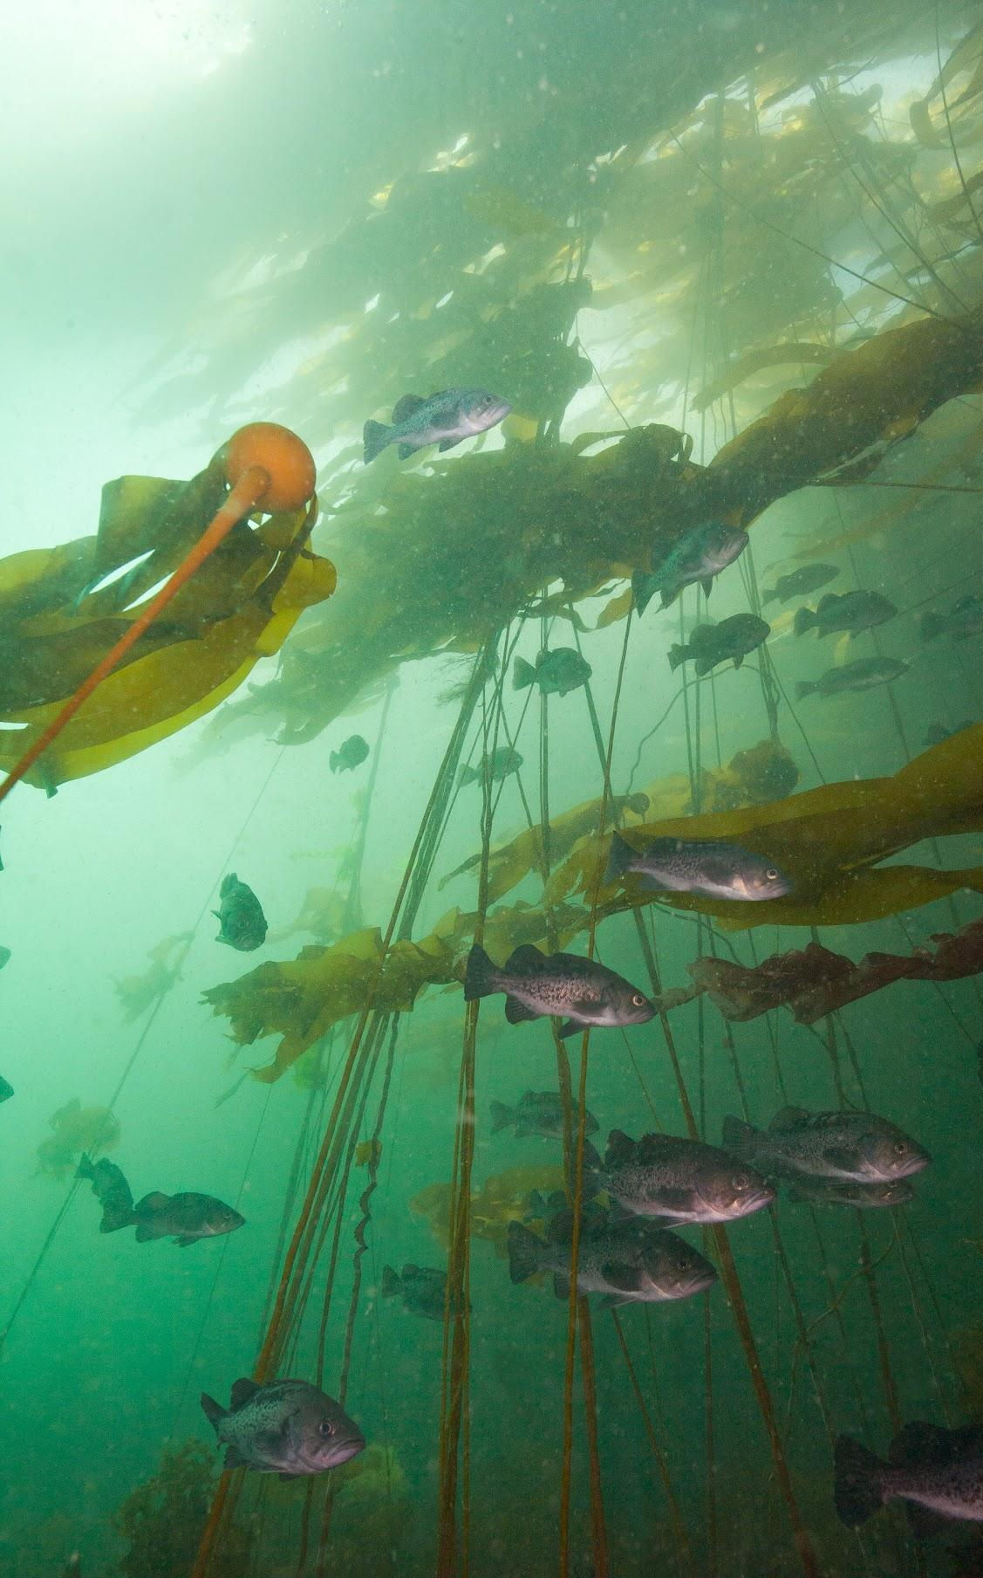
Why are we going there?
Fish Eye Project wants you to experience the underwater world, as a fish would!
We hope that you'll think about the ocean and water in a new way.

Slide 16
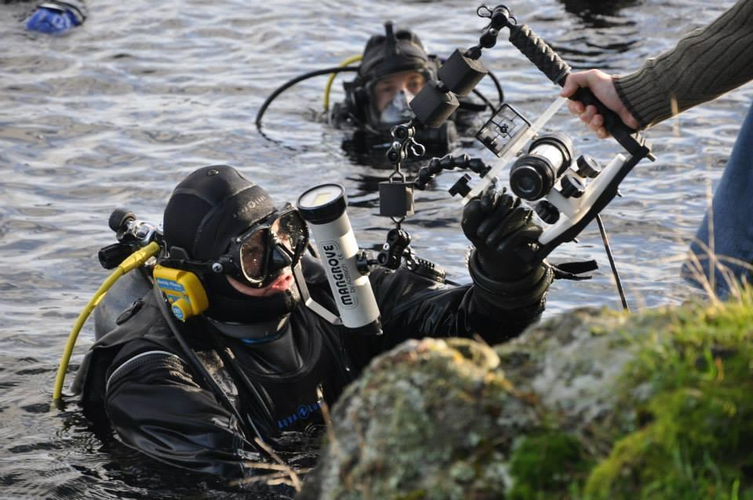
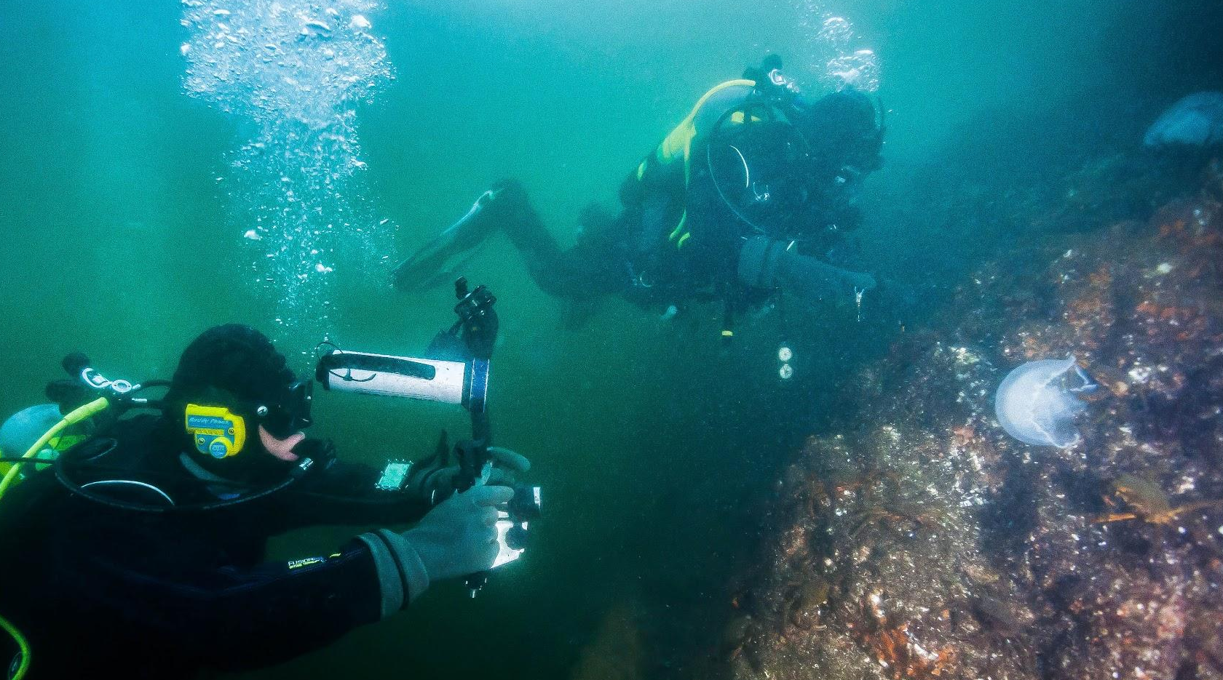
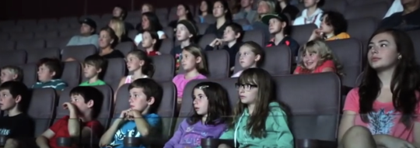
How are we getting there?

Slide 17
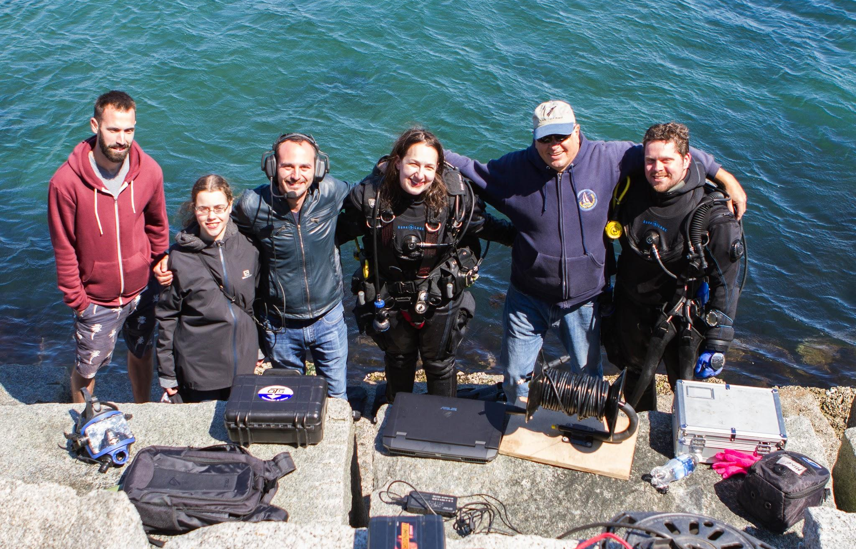
Who are we sending?
Diver Michael Blazecka
Diver Rowan Dowling
Surface
attendant Mike Irvine
Diver Keely Langford

Slide 18
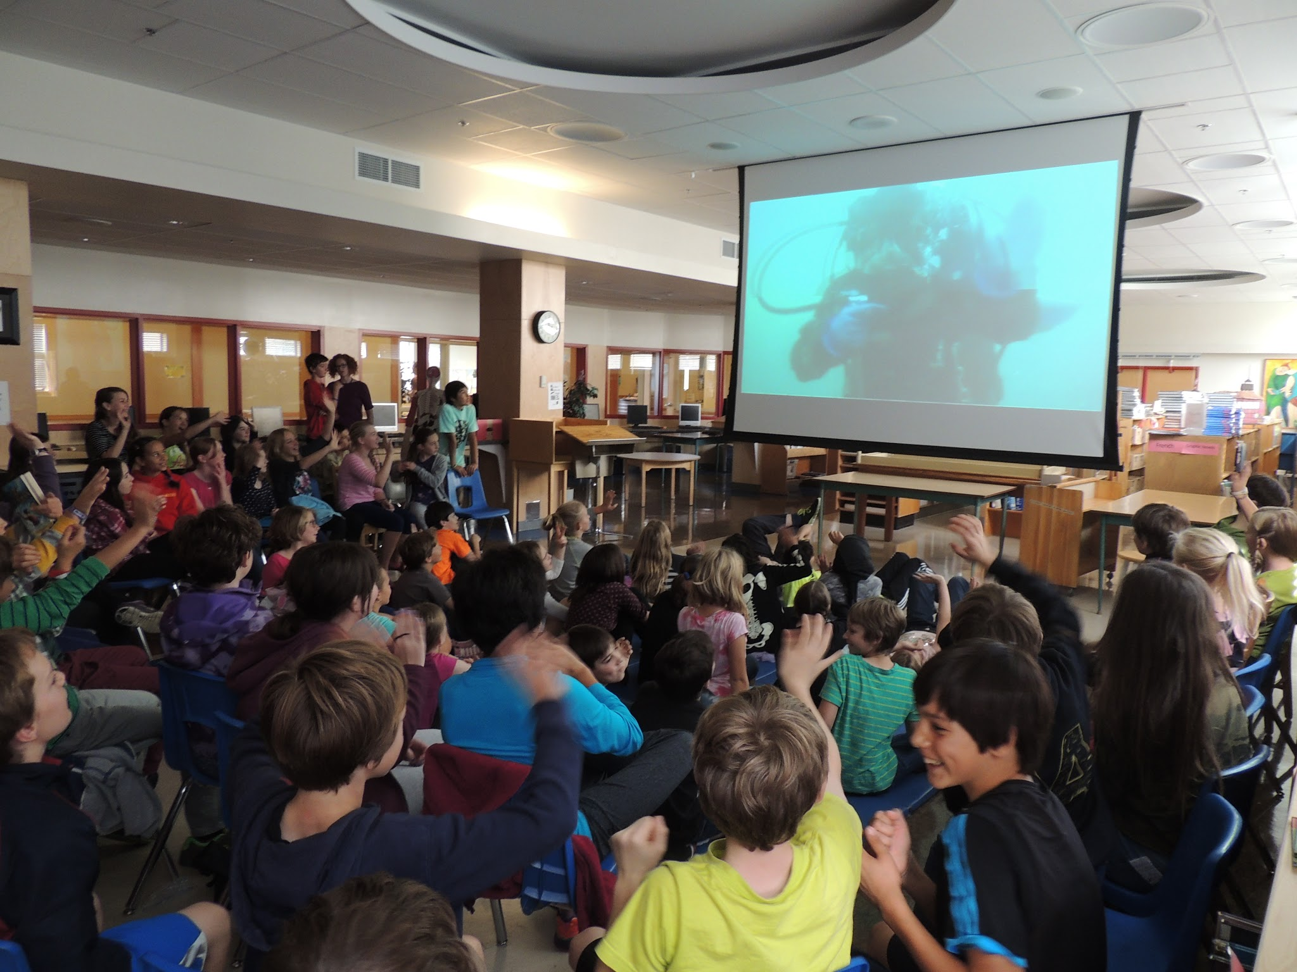
Who are we sending?
But most importantly...
YOU!
the
dry
divers

Slide 19
Prepare your dive:
Fill out a Live Dive Log
I know that…
I wonder if…
I hope that…

Slide 20
What’s Next?
Visit FishEyeProject.Org
and follow us on Facebook and Twitter
Subscribe to our YouTube Channel
to see previous and upcoming dives
Stay tuned for a Wild Salmon Run
Live Dive in September!

